Slide 1
Alzheimer’s Disease Trends in the United States and Tennessee from 1999-2018
Capstone Project for Nashville Software School Data Analytics Cohort 2
John Posey
Data Analyst

Slide 2

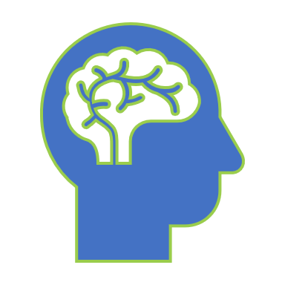
How does your Brain work?

Slide 3
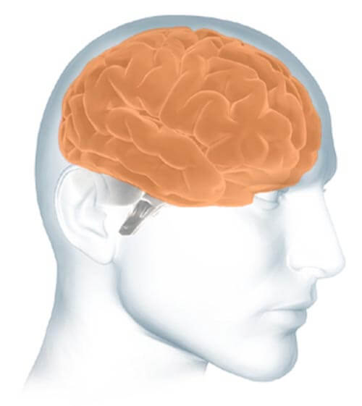
Parts of the Brain
The cerebrum fills up most of your skull. It is involved in remembering, problem solving, thinking, and feeling. It also controls movement.
https://www.alz.org/alzheimers-dementia/what-is-alzheimers/brain_tour

Slide 4
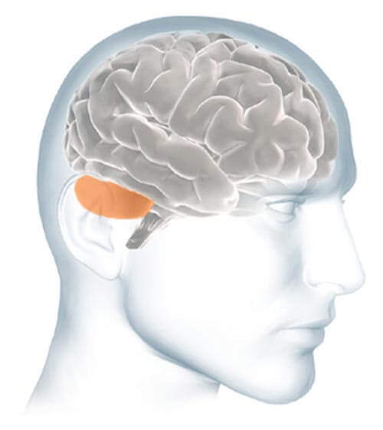
Parts of the Brain
The cerebellum sits at the back of your head, under the cerebrum. It controls coordination and balance.
https://www.alz.org/alzheimers-dementia/what-is-alzheimers/brain_tour

Slide 5
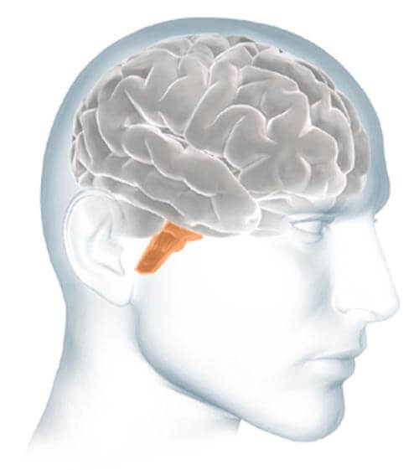
Parts of the Brain
The brain stem sits beneath your cerebrum in front of your cerebellum. It connects the brain to the spinal cord and controls automatic functions such as breathing, digestion, heart rate and blood pressure.
https://www.alz.org/alzheimers-dementia/what-is-alzheimers/brain_tour

Slide 6
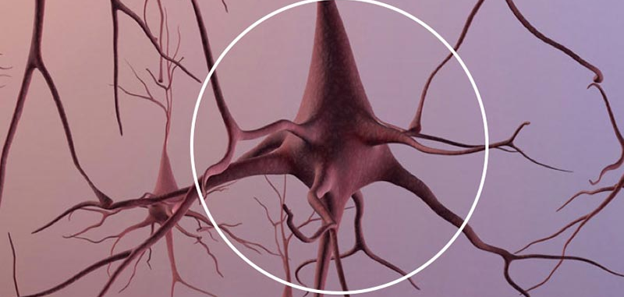
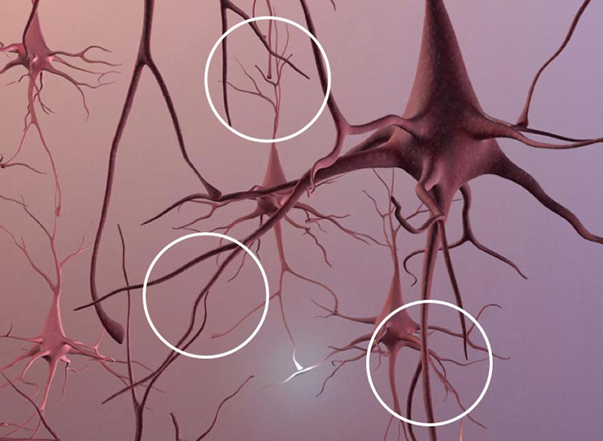
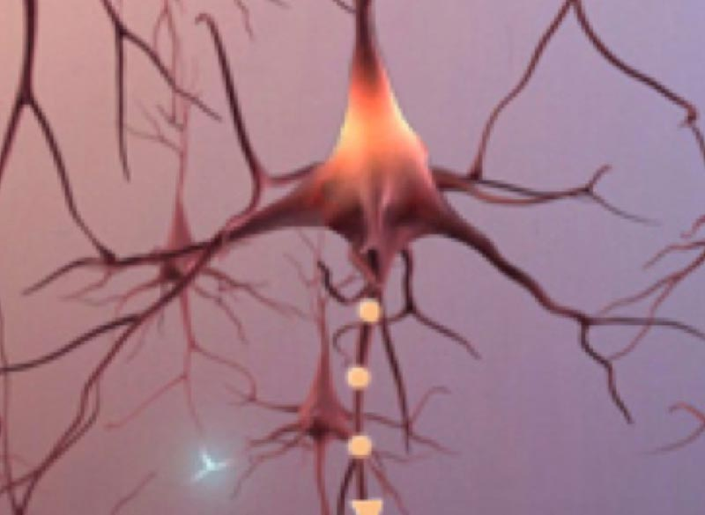
Neurons
Total Neurons
Branches
Signals
An adult brain contains about 100 billion nerve cells.
Branches connect the nerve cells at more than 100 trillion points. Scientists call this dense, branching network a "neuron forest."
Signals traveling through the neuron forest form the basis of memories, thoughts, and feelings.

Slide 7

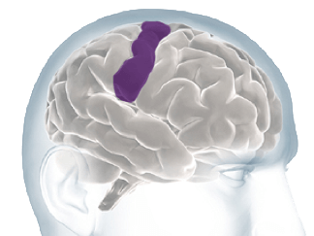
Interpret Sensations From Your Body
Interpreting the

Slide 8
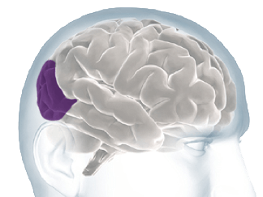
Interpret Sensations From Your Body
Interpreting the

Slide 9
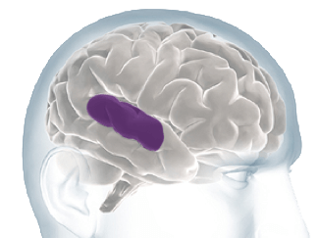
Interpret Sensations From Your Body
Interpreting the

Slide 10
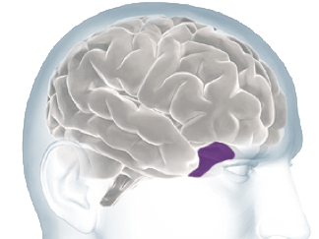
Interpret Sensations From Your Body
Interpreting the

Slide 11
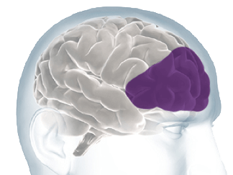
Interpret Sensations From Your Body
Interpreting the

Slide 12
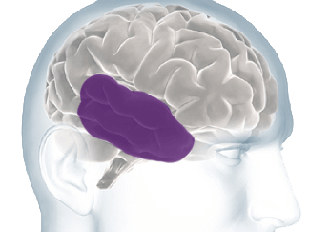
Interpret Sensations From Your Body
Interpreting the

Slide 13
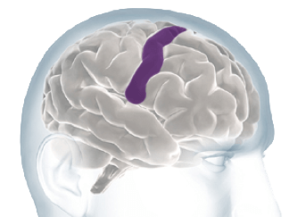
Interpret Sensations From Your Body
Interpreting the

Slide 14
Alzheimer’s Disease pathology and presentation
What Alzheimer’s Disease is?
how it affects those diagnosed?
how does the prolonged nature of the disease affect the healthcare system?

Slide 15
Alzheimer’s Disease, Brain Function, and Cognitive Decline
Ad’s effect on brain function and the resulting cognitive decline.

Slide 17
Overall Trend in the United States 1999-2018
Overall trend in AD–related deaths in the United States between 1999-2018.

Slide 19
Overall Trend in Tennessee 1999-2018
Overall trend in AD–related deaths in TEnnessee between 1999-2018.

Slide 21
Caregiving trends and overall statistics

Slide 23
What to do if someone you love has Alzheimer’s Disease?
A short guide for Family and friends

Slide 25
Resources
Links to various organizations and programs for help.

Slide 27
Bibliography
I would like to give credit to the following resources for the data that I used for this presentation.

